Slide 1


Time Series (GPU)
Under the Guidance of Dr. K V Subramaniam
Alok Shankar 1PI12CS019
Rachita Pradeep 1PI12CS128
Shruti Agarwal 1PI12CS164

Slide 2
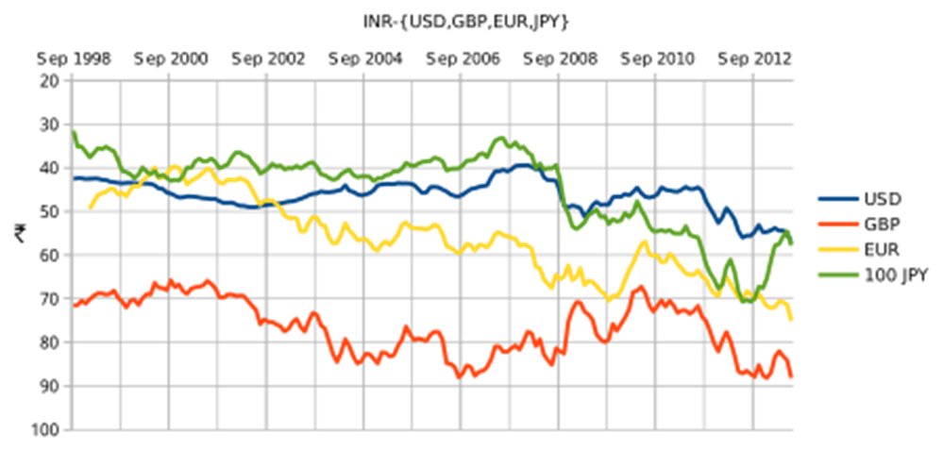
Introduction to Time Series
A time series is a sequence of data points, measured typically at successive points in time spaced at uniform time intervals.
Examples of time series data are
Human genome project data
NASA observation satellites(can generate data at rate of 1 terabyte per day)
Streams of stock prices
Patient monitors

Slide 3
Application of Time Series Analysis
The ECG of the human heart is a time series.
In order to detect certain abnormalities in the heart (E.g.. Heart attack), time series analysis has to be done.
In order to do this the heart attack pattern is considered and is compared with the ECG of the person under consideration.
Such analysis is also used in Speech recognition, Weather prediction, Stock analysis, etc.

Slide 4
Literature Survey
Two key aspects for achieving effectiveness and efficiency when managing time series data are representation methods and similarity measures.
Several techniques have been proposed in the literature for representing time series like Piecewise Aggregate Approximation, SAX representations, singular value decomposition, etc.
There are over a dozen distance measures for similarity of time series data in the literature like Dynamic time warping, Euclidian Distance etc.
In spite of the consideration of dozens of alternatives, there is increasing evidence that the classic Dynamic Time Warping (DTW) measure is the best measure in most domains .

Slide 5
Time Series Analysis by UCR DTW
DTW is a similarity measure, which allows a one-to-many mapping of data points of the two sequences.
The standard DTW algorithm is very slow. This is improved in the UCR suite by implementing optimisations like
Z-Normalisation
Lower bounding – LB_Kim, LB_Keogh, LB_Keogh(data and query reversed)
Early Abandoning of DTW calculation, Z-normalisation and LB_Keogh
Reordering early abandoning
Cascading of lower bounds
Using squared distances

Slide 6
LB_KIM
The lower bound is given by the squared difference between the two sequence’s first (A), last (D), minimum (B) and maximum(C) points.
Implementation
The minimum (B) and maximum(C) points are not considered in the code because of z-normalization the top and bottom cannot give significant benefits.
The code considers the first 3 points and the last 3 points.
The pruning power of LB_Kim is non-trivial, especially when the query is not long, say in length 128
C
A
D
B

Slide 7
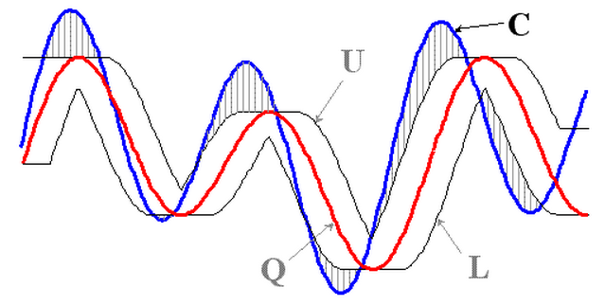
LB_KEOGH
LB_Keogh, the best-so-far known method to lower bound DTW.
In this paper we use an envelope-based lower bound technique.

Slide 8
DTW DISTANCE
Formula :
γ(i,j) = δ(i,j) + min[γ(i-1,j), γ(i-1,j-1), γ(i,j-1)]
T
T
S
S
Warping path w

Slide 9
Advantages of UCR DTW
It is exact, not approximate.
It does not require parameters to be set.
It correctly z-normalizes the data.
It has no minimum or maximum query length.
It can also handle exact queries under uniform scaling
Finally, we are simply much faster than any known technique.

Slide 10
Work Done So Far
Multi-core:
Parallelisation of Reading and Writing
Parallelisation of UCR DTW implementation
Parallelisation on Hadoop
Parallelisation on Spark
Web application for graphical representation.
Irregular time Series

Slide 11
Problem Definition
To Parallelize the existing UCR DTW algorithm on GPU in order to increase the time efficiency.
To utilize the GPU cores efficiently in order to obtain maximum possible speedup in finding the closest match.
To come up with a more efficient design to avoid warp divergence.
To experiment with launching of multiple concurrent kernel.
To decrease the amount of time taken to read the data from the input file. To compare the UCR implementation, the multicore implementation and the GPU implementation in terms of performance.

Slide 12
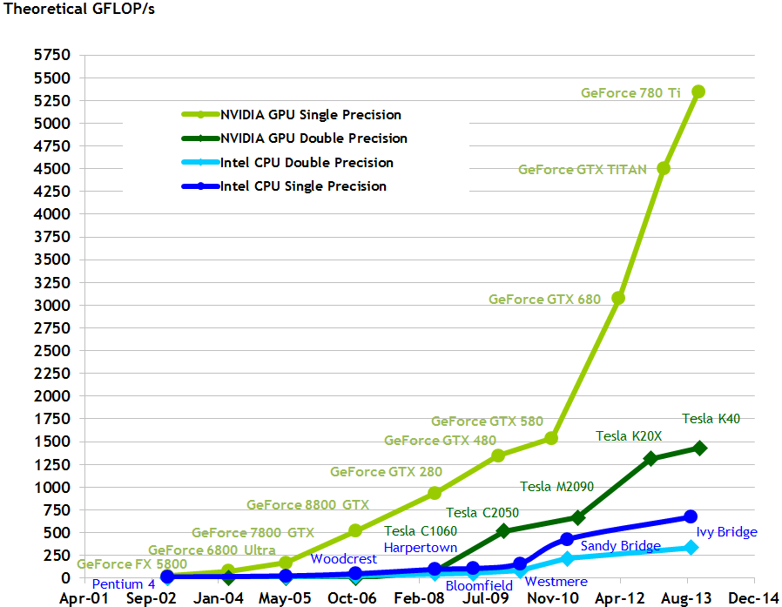
Why GPU?
The performance increase between successive generations of CPU’s have flat lined in the recent years and Moore’s law is waning because CPU transistors are approaching their limits of physics.
In such a scenario, the best way to scale would be to parallel processing on GPU’s as the performance of GPUs have exponentially increased in the recent years.
Why nVidia CUDA
nVidia CUDA is a much more stable ecosystem for developers since it has existed for a longer time than competitors and hence has better developer support.

Slide 13
Differences between a GPU and a CPU
Lower clock speeds of GPUs when compared to CPUs : Current GPUs have much lower clock speed when compared with those of the CPUs. This make even relatively small serial parts in algorithms to execute immensely slow.
SIMD nature of the GPUs : GPUs employ the SIMD method of instruction to achieve parallelism. A set of threads in a GPU are issued same instruction but may work on different data.

Slide 14

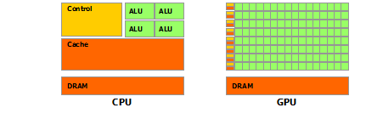
Nvidia Cuda Architecture - 1
'CUDA ', ie Compute Unified Device Architecture is a parallel computing platform and programming model created by NVIDIA and implemented by GPUs that they produce. CUDA gives developers direct access to the virtual instruction set and memory of the parallel computational elements in CUDA GPUs.
As seen from the figure, GPUs have inherently more processing power compared to CPUs since they devote less die area to cache and complex control units.
The process of graphical rendering which requires high parallelization capabilities make a GPU the ideal device for parallel computing needs of this project.

Slide 15
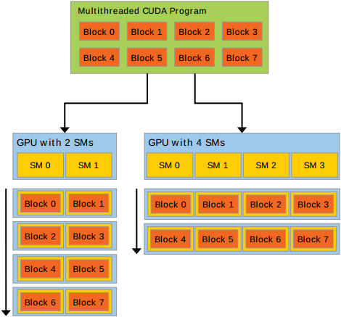
Nvidia Cuda Architecture - 2
The Nvidia Cuda Toolkit at its core are three key abstractions - a hierarchy of thread groups, shared memories, and barrier synchronization - that are simply exposed to the programmer as a minimal set of language extensions to the C programming language.
A GPU is built around an array of Streaming Multiprocessors (SMs). A multithreaded program is partitioned into blocks of threads that execute independently from each other, so that a GPU with more multiprocessors will automatically execute the program in less time than a GPU with fewer multiprocessors.

Slide 16
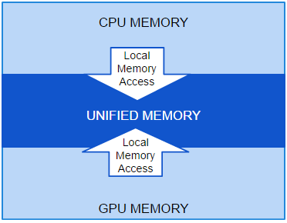
Unified Memory
Unified memory was an abstraction that unified the GPU and CPU memories into one homogeneous memory unit called Unified memory introduced in CUDA 6.5.
Why Unified Memory?
It Simplifies programming by enabling applications to access CPU and GPU memory without the need of manually moving data
The managed memory can be accessed by a single memory pointer

Slide 17
Shared Memory in GPU
What is shared memory:
Stored in on chip shared memory
Very low latency
Accessible by all the threads in the same thread block
Lifetime : Thread block
Use of shared Memory in our project
To achieve the maximum efficiency it was very obvious to put the data in the query file in shared memory as it is most used since the distance calculation for each candidate requires this data.
RESULTS: It gave a speedup of approximately 20 percent.

Slide 18
Implementation Of Keogh On GPU
We were able to successfully implement another pruning method [KEOGH] of UCR on GPU.
The results of this implementation are as follows :
For 2.8 GB Data File :
Time taken by KIM on GPU : 52 s
Time taken by KIM + KEOGH on GPU : 72 s
As we can see from the above results that Keogh didn’t give the expected results. Keogh reduces the time taken by UCR on CPU to almost half.
Hence, Pruning by Keogh is not very effective on GPU.
The reason for this unexpected behaviour by Keogh on GPU was warp divergence in GPU.

Slide 19
Warps in GPU
What are warps
All threads on a GPU are grouped into warps.
All threads in a warp are given the same instructions.
Every thread waits for every other thread to complete before the next instructions are executed.
This makes the use of IF-ELSE constructs very costly in terms of execution time.
CUDA implements Barrier locking to coordinate threads. Because of this mechanism, Warp divergence takes place which slows down the program.
Warp divergence in GPU
This method of pruning off candidates, if ported directly onto a GPU will show degraded performance due to warp divergence.
For example, if a warp contains 32 threads and the pruning algorithms prune off 31 of the candidate being considered(one by each thread) then these 31 threads await the compltion of the one thread whose candidate did not get pruned eoff. This is as bad as all the 32 candidates not getting pruned off.

Slide 20
Pipeline Architecture
DTW and pruning algorithms (KIM and KEOGH) are separated into “stages”.
Each stage runs on it’s own kernel and in parallel to each other.
There are two buffers, KIM_KEOGH and KEOGH_DTW which are implemented on the unified memory, which are essentially synchronized circular queues.
The read and write to these circular queues are synchronized using semaphores akin to a producer consumer problem
LB_KIM reads through the data file and prunes the candidate set and stores the reduced set in the KIM_KEOGH buffer which LB_KEOGH reads from.
LB_KEOGH prunes the candidate set in KIM_KEOGH buffer and stores the reduced set in the KEOGH_DTW buffer which which DTW reads from.
This allows all three kernels, KIM, KEOGH, DTW to execute in parallel without racing while accessing the common buffer memory spaces

Slide 21
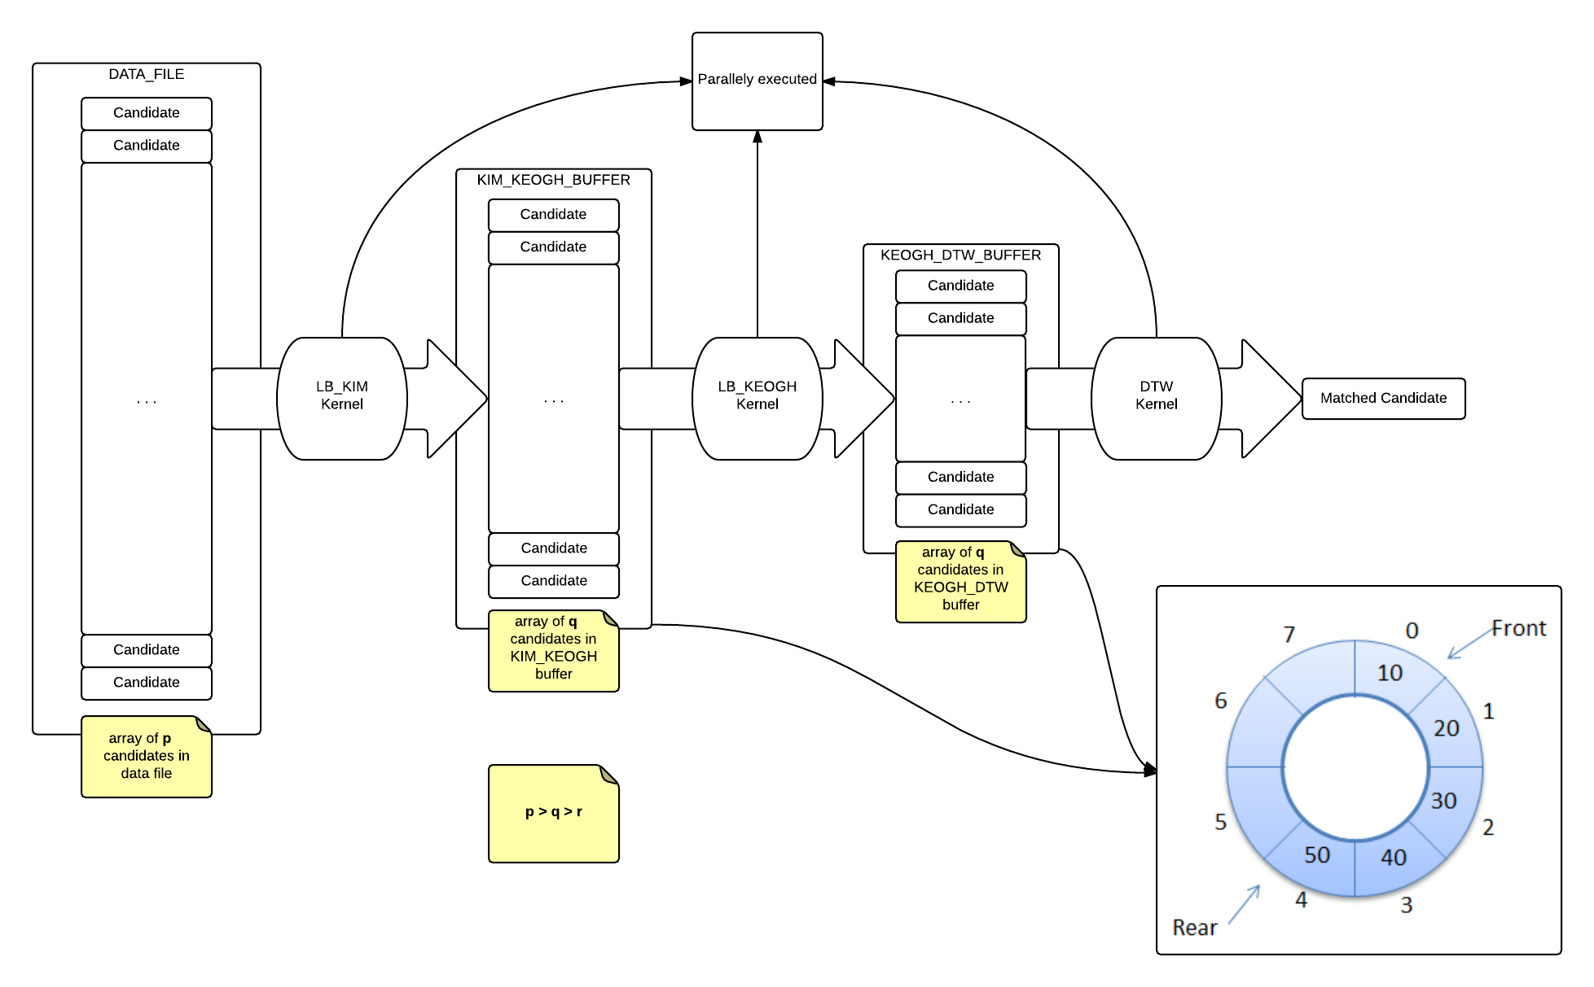
Pipeline Architecture

Slide 22
READING OPTIMISATIONS
On profiling the code and tracing the timing of the components of the implementation, we observed that reading the data file took longer than the actual GPU processing. In order to mitigate this, We came came up with better implementations of the reading mechanizm:
Normal Reading(Original): Used the fscanf() function to read data points from the file.
Binary Read: Converted the raw text file into a binary file. Reading from the Binary file yielded better results.
Buffered Read: Normal Reading invokes the hardware(DMA’s, etc) for every single number to read which makes it slow. To increase the performance, the new algorithm reads 4KB of text data into the memory and parses the numbers from memory.

Slide 23
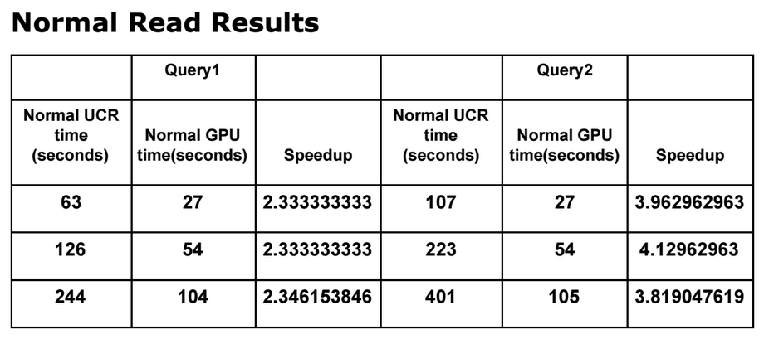
Results

Slide 24
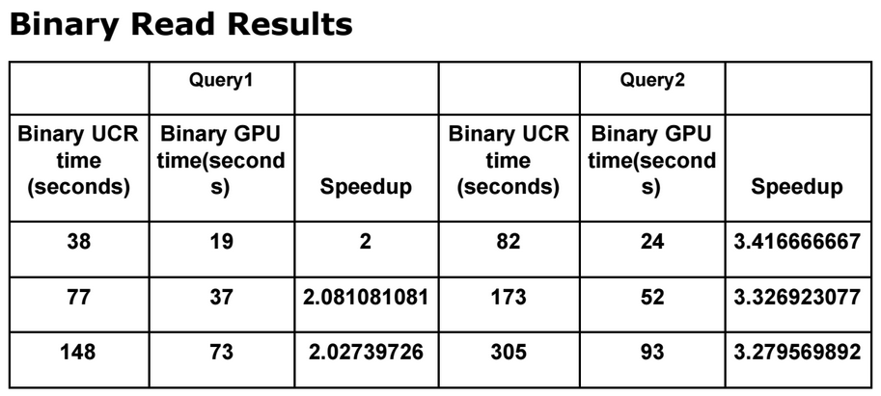
Results

Slide 25
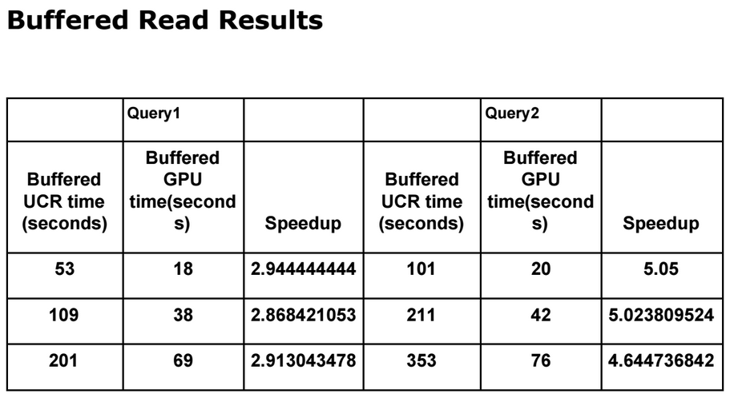
Results

Slide 26
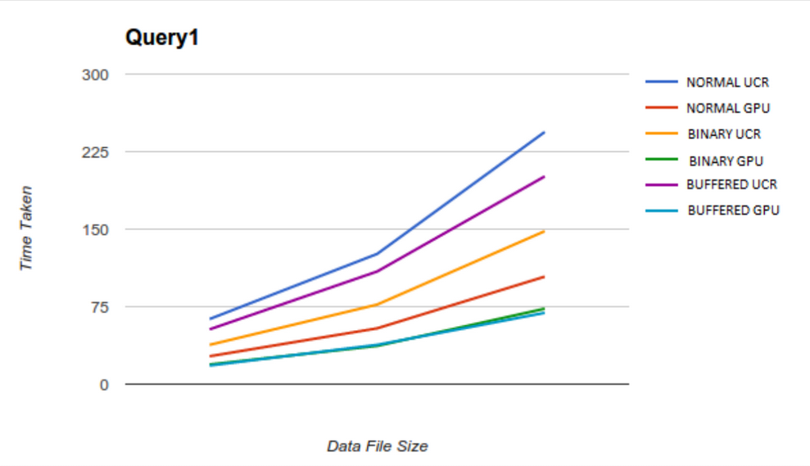
Results

Slide 27
UCR BAD QUERY
On Experimentation with several query files, We observed that the UCR algorithm was inefficient for some query files. We came to the conclusion that this was caused because LB_KIM and LB_KEOGH were not effective, i.e the number of candidates pruned off is decreased.
The strength of the UCR optimizations for DTW lies in the pruning methods (LB_KIM, LB_KEOGH) and such bad query files affect the performance of the algorithm.
In comparison, the GPU algorithm does not suffer this setback since the parallel mathematical computational capacity of the GPU is the reason behind the speedup of the algorithm and not the pruning methods.

Slide 28
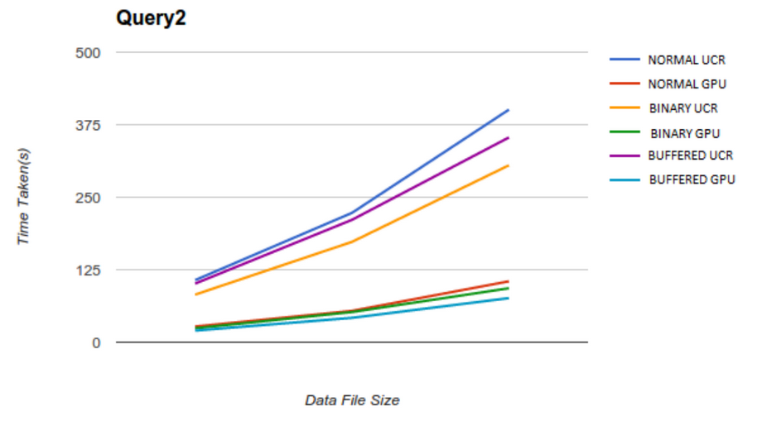
Results

Slide 29
Conclusion
We have achieved a speedup of upto 540% with respect to UCR but we are now looking at further optimizations to get better speed.
In the current state of our project, we have been able to successfully implement the following:
Implemented the Pipeline architecture to overcome warp divergence
Utilized better reading mechanizm for reducing read time.
Unified memory to reduce the time for cudamemcopy( )
Use of shared memory to store the frequently used query data
Locking system to handle multiple threads accessing and modifying the BSF in parallel.

Slide 30
Future Enhancements
Putting the Query in shared memory gave us a significant speed up. Therefore we will also try putting a part of the data on the shared memory to get further speed up.
Look into alternate GPU memory like shader memory.
Making GPU clusters just like a SPARK or Hadoop Cluster to further increase the efficiency.
Find ways to optimise a Cuda code just like compiler optimisation for gcc works.(O3 flag)
Try parallelising algorithms other than DTW on GPU
Reducing the number of if else conditions in the code and replace them with Boolean expressions as far as possible.

Slide 31
Bibliography
1. Distributed Aggregation for Data-Parallel Computing: Interfaces and Implementations Yuan Yu Pradeep Kumar Gunda Michael Isard
2. Searching and Mining Trillions of Time Series Subsequences under Dynamic Time Warping. Thanawin Rakthanmanon, Bilson Campana, Abdullah Mueen, Gustavo Batista, Brandon Westover, Qiang Zhu, Jesin Zakaria, Eamonn Keogh
3. http://docs.nvidia.com/cuda/pdf/CUDA_C_Programming_Guide.pdf
4. http://devblogs.nvidia.com/parallelforall/unified-memory-in-cuda-6/
5. H. Ding, G. Trajcevski, P. Scheuermann, X. Wang, and E. J. Keogh. 2008. Querying and mining of time series data: experimental comparison of representations and distance measures. PVLDB
6. http://www.cs.ucr.edu/~eamonn/LB_Keogh.htm
7. http://www.cs.ucr.edu/~eamonn/UCRsuite.html
8. CUDA C/C++ Streams and Concurreny
9. Advance CUDA topics - Part 5, Concurrent Execution, Pierre-Yves Taunay

Slide 32
THANK YOU

